Slide 1
GROUP 11

Slide 2
Members:
01
Phạm Hoàng Phước
02
Đặng Hoàng Sơn
03
Lê Trịnh Hoàng Phú

Slide 3
Introduce

Slide 4
Delivery App
Solve the problem of transporting
Save time
Convenient
Save money
Safe
Easy Payment

Slide 5
Diagram

Slide 6
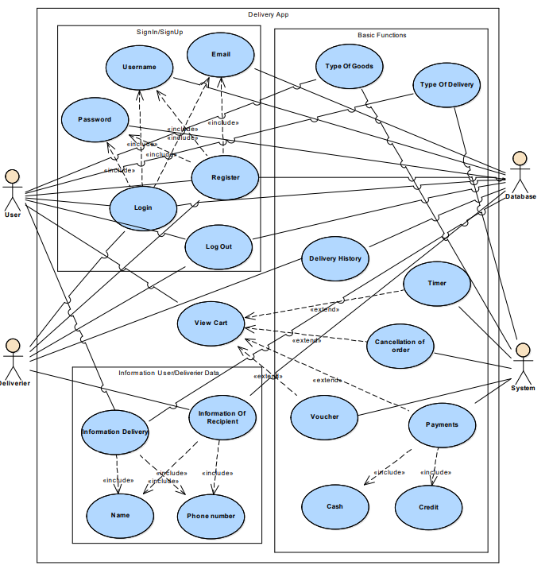
Use Case Diagram

Slide 7
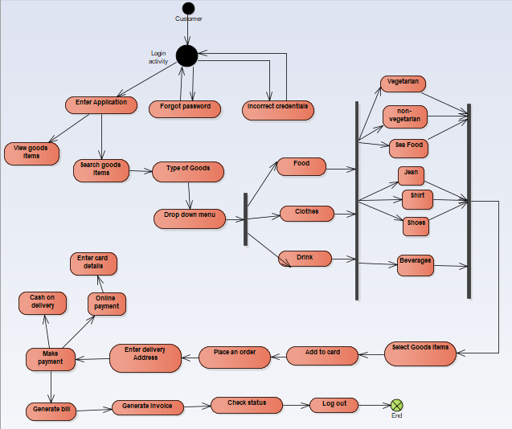
State Diagram

Slide 8
Design Pattern

Slide 9
Design Pattern
Factory
Add Text
Simple PowerPoint Presentation
Adapter
Singleton
Bridge
Prototype

Slide 10
Factory Pattern

Slide 11
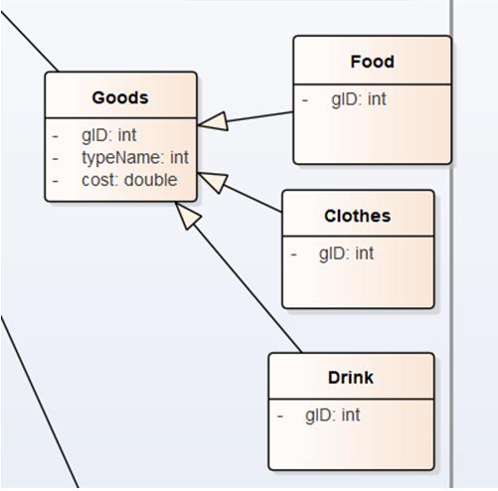
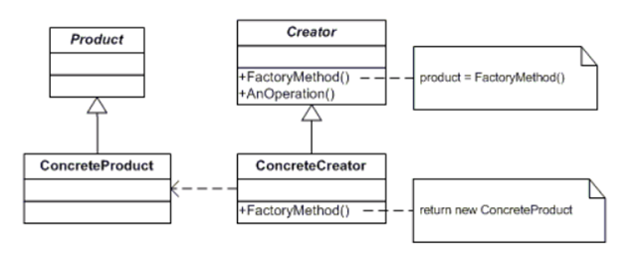
Factory Pattern

Slide 12
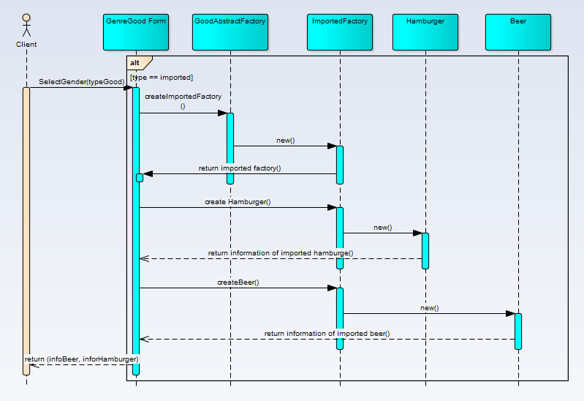
Factory Pattern

Slide 13
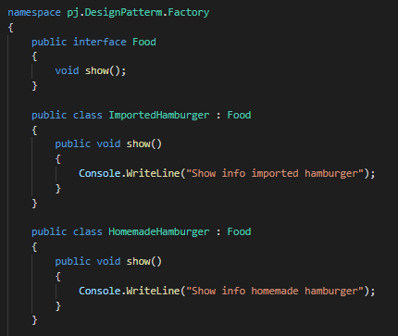
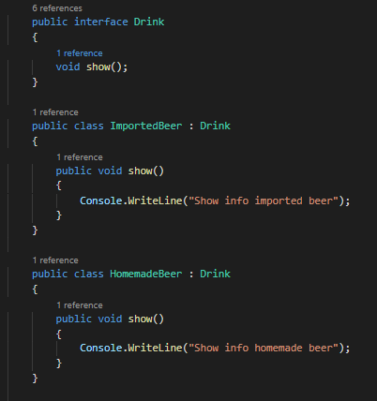
Factory Pattern

Slide 14
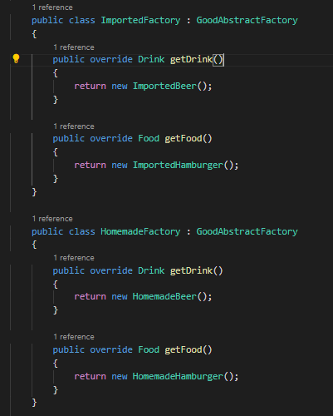
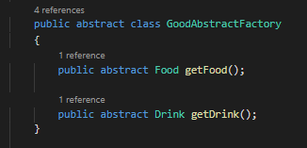
Factory Pattern

Slide 15
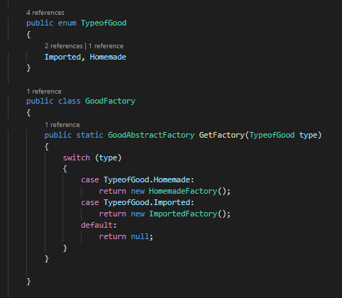
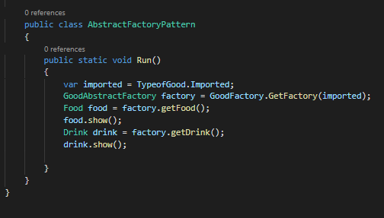
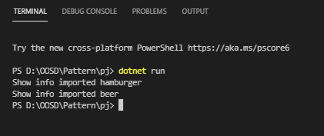
Factory Pattern

Slide 16
Singleton Pattern

Slide 17
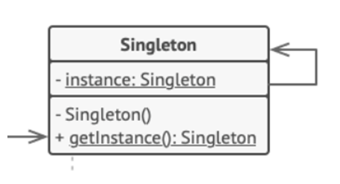
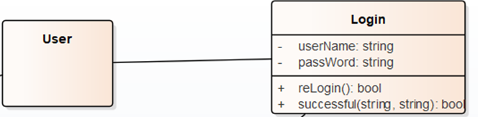
Singleton Pattern

Slide 18
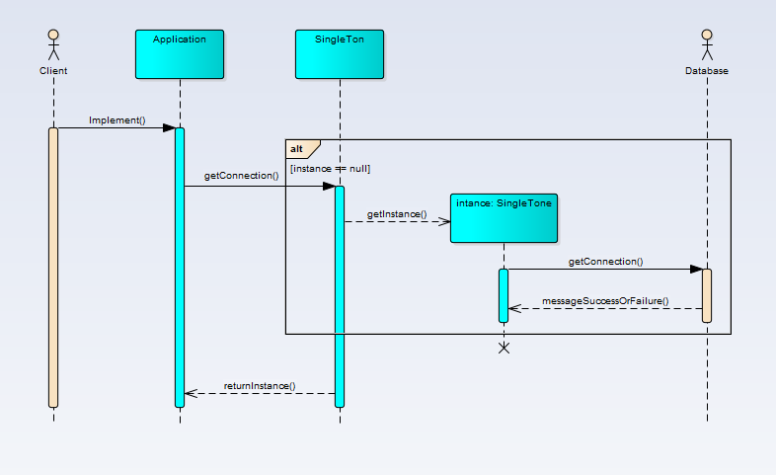
Singleton Pattern

Slide 19
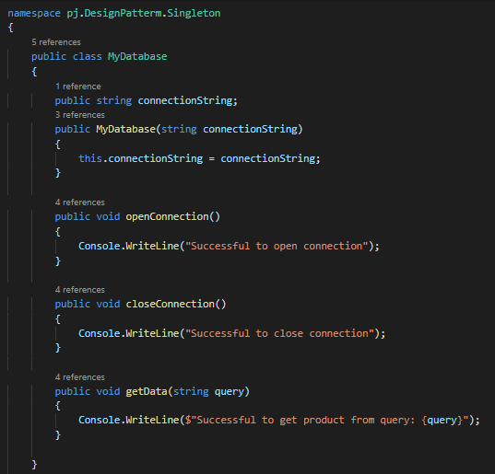
Singleton Pattern

Slide 20
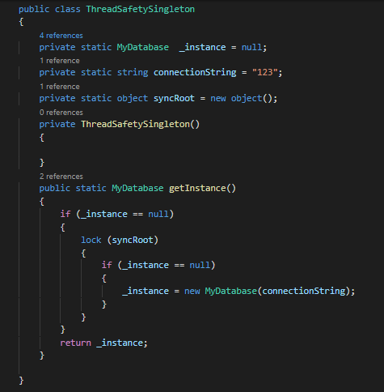
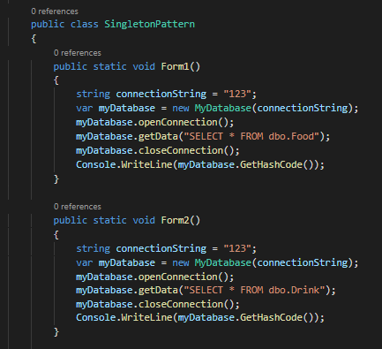
Singleton Pattern

Slide 21
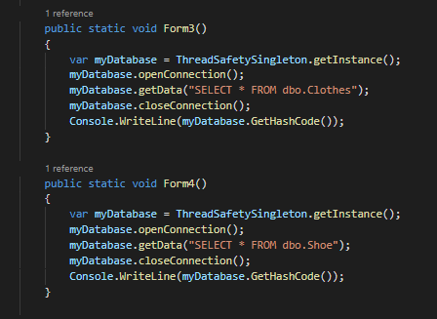
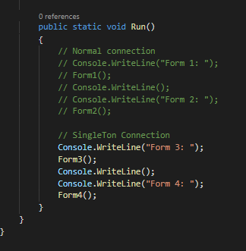
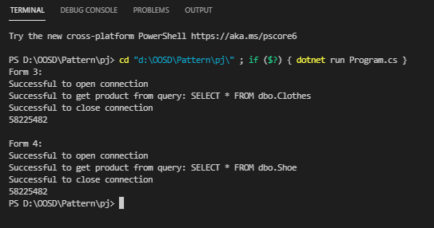
Singleton Pattern

Slide 22
Prototype Pattern

Slide 23
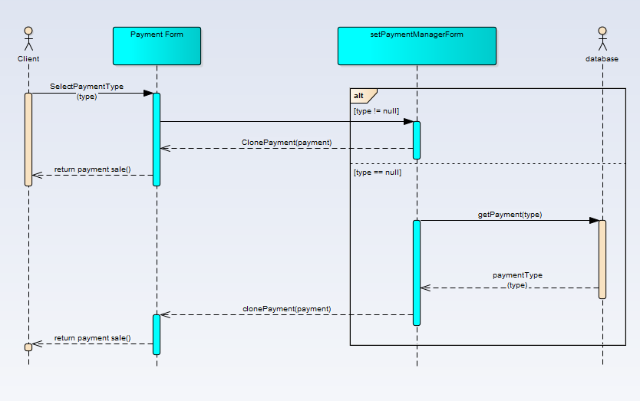
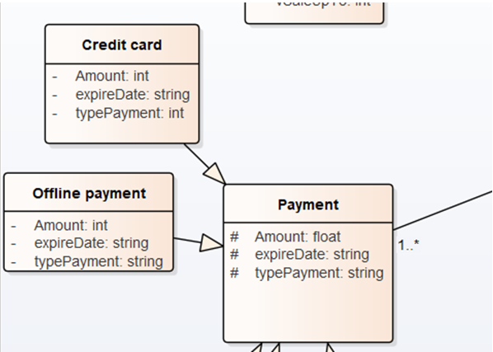
Prototype Pattern

Slide 24
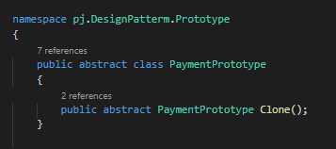
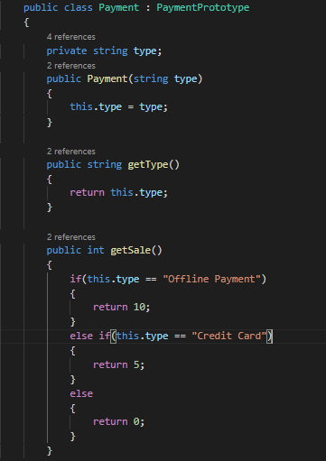
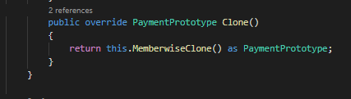
Prototype Pattern

Slide 25
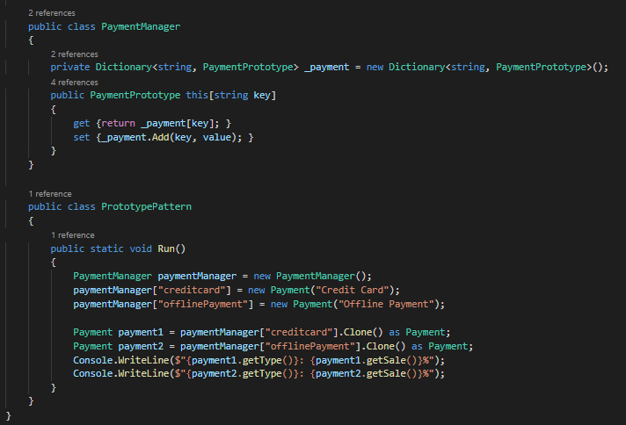
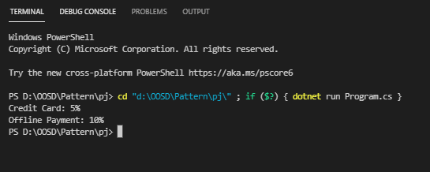
Prototype Pattern

Slide 26
Adapter Pattern

Slide 27
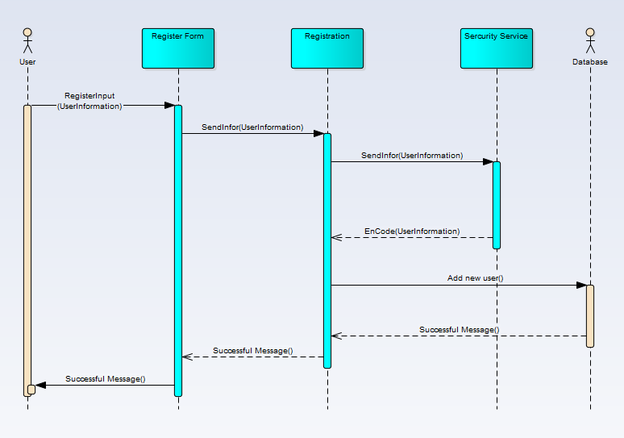
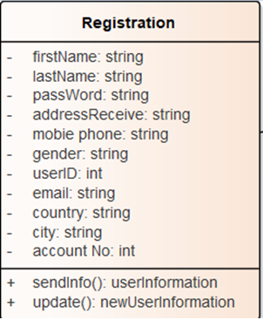
Adapter Pattern

Slide 28
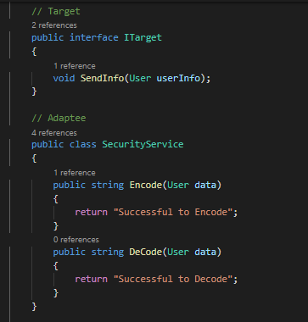
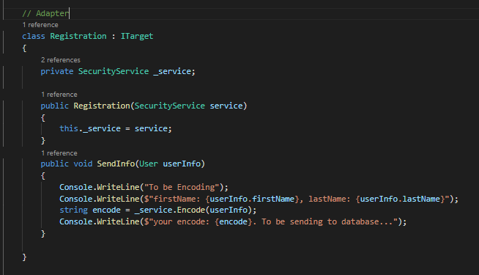
Adapter Pattern

Slide 29
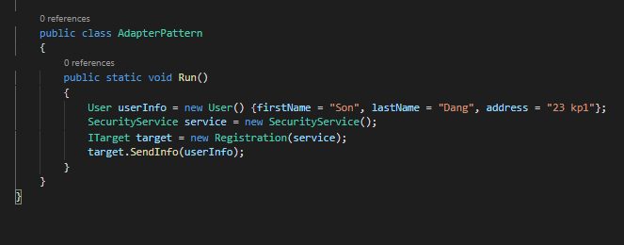
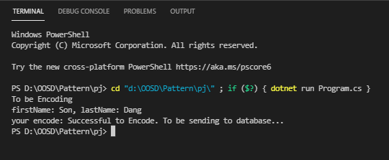
Adapter Pattern

Slide 30
Bridge Pattern

Slide 31
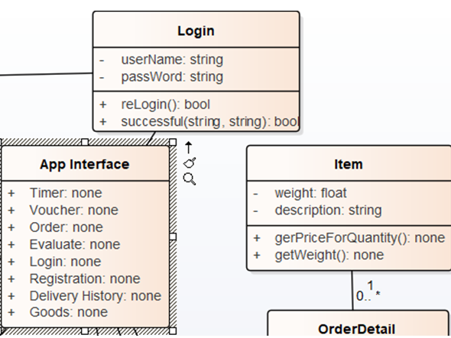
Bridge Pattern

Slide 32
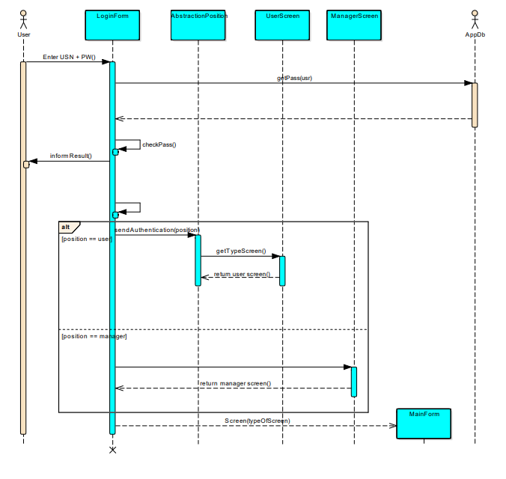
Bridge Pattern

Slide 33
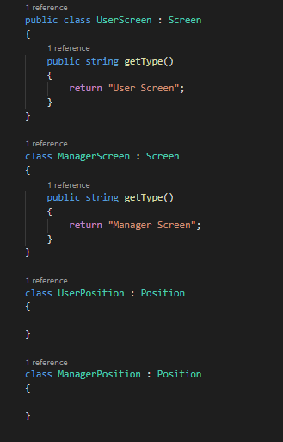
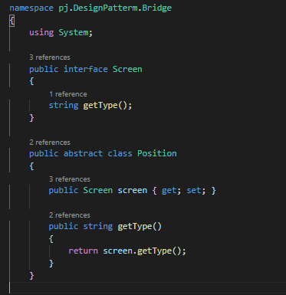
Bridge Pattern

Slide 34
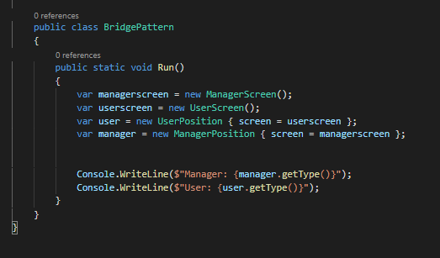
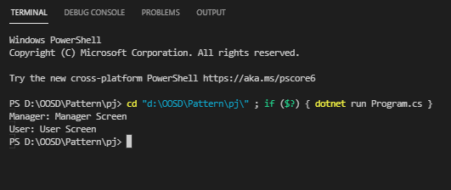
Bridge Pattern

Slide 35
THANK YOU

